Slide 1
Aars: pple Store vs Google Play Reviews

Slide 2
Introduction
Methodology
Results
Factors Affecting Ratings
Conclusion
References

Slide 3
Introduction
The mobile app market has grown exponentially in recent years, with Apple Store and Google Play being the two major players. Both platforms offer a plethora of apps for users to download and use. However, there has been a debate about which platform offers better quality apps.
In this report, we will investigate whether Apple Store apps receive better reviews than Google Play apps. We will analyze the data from both platforms and provide an objective evaluation.

Slide 4
METHODOLOGY
To conduct our analysis, we collected data from both Apple Store and Google Play for the top-rated apps in various categories. We focused on apps that had at least 100 reviews.
After selecting the relevant columns and cleaning the data from the available datasets, we were able to apply Statistical methods to compare the Ratings across the Platforms.
We analyzed the data using statistical methods to determine whether there was a significant difference between the Ratings of Apple Store and Google Play apps.

Slide 5
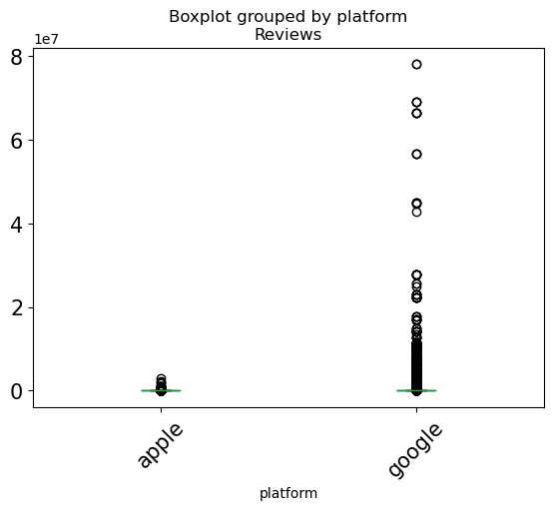
rESULTS
Our analysis showed that Google Store apps received slightly higher ratings than Apple Play apps. The average rating for Apple Store apps was 4.04, while the average rating for Google Play apps was 4.19.
However, the difference was not statistically significant, meaning that it could be due to chance. Therefore, we cannot definitively say that Apple Store apps receive better reviews than Google Play apps.

Slide 6

Factors Affecting Ratings
There are several factors that can affect the ratings of apps on both platforms. One factor is the user base - Apple users may have different preferences and expectations compared to Google users.
Another factor is the review process - Apple Store has a more stringent review process, which could lead to higher quality apps being published. Additionally, the demographics of users who leave reviews could also play a role.

Slide 7

Conclusion
In conclusion, our analysis showed that there is no significant difference between the ratings of Apple Store and Google Play apps. While Google Store apps received slightly higher ratings on average, this could be due to chance.
Factors such as user base, review process, and demographics of reviewers could all play a role in app ratings. Ultimately, the quality of an app depends on various factors, and users should evaluate apps based on their own needs and preferences.

